Slide 1
ELECTRICAL PROGRESS REPORT WEEK 3
TEAM
-Eunice Orenge
-Laban Mwangi
-Stephen Kinuthia
-Victor Maina

Slide 2
OBJECTIVES OF THE WEEK;
Troubleshoot the motor controller fault alarm.
Research on DC-DC converters.
Visualize the high voltage & low voltage circuits in the electrical subsystem.

Slide 3
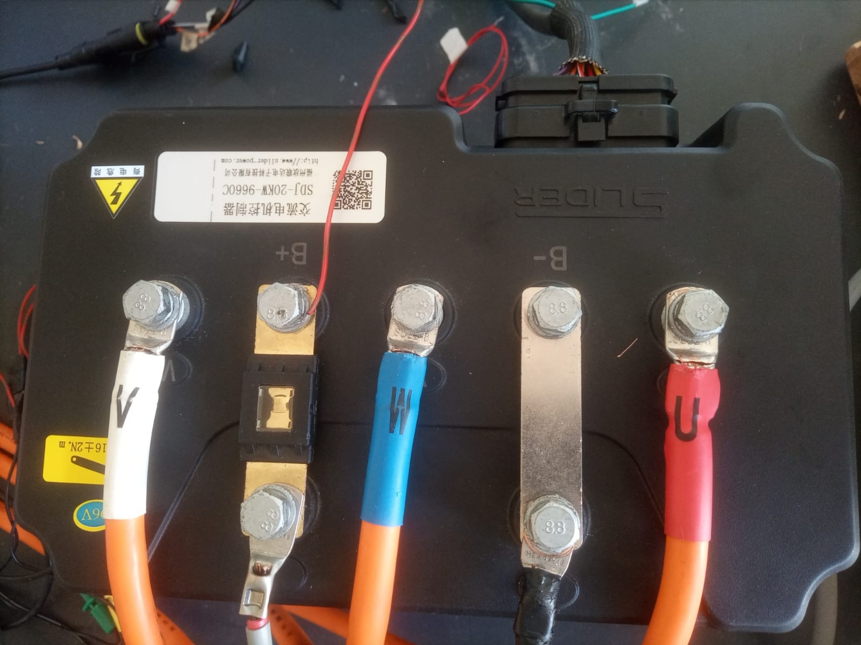
1) Troubleshooting the motor controller
96v SLIDER ACIM CONTROLLER

Slide 4
Research
-We are still having trouble trying to run the motor.
-The manual available is shallow, with limited troubleshooting steps.
-Our research work yielded the following results;
a) Possible causes for the accelerator fault.
b) Ways on how to solve the fault and reset the controller.
-Our best lead was a manual that we got online. However, it was of a different controller and also not from the Slider manufacturer.

Slide 5
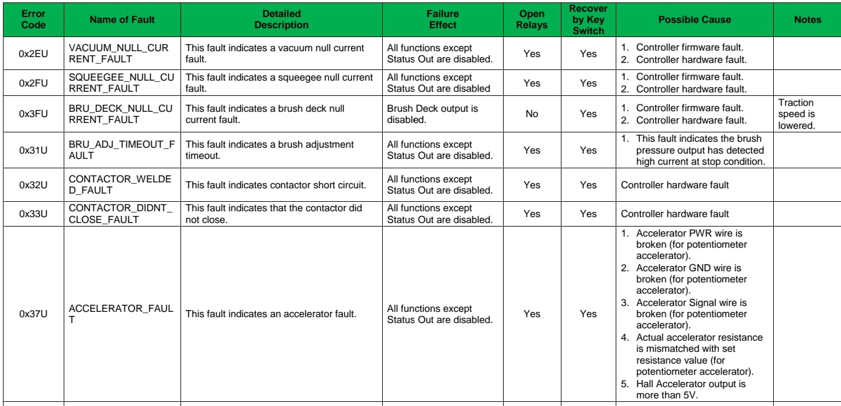
KCCA0391 manual troubleshooting section

Slide 6
Possible Solutions
-We proceeded to look into for the possible causes proposed by this manual but to no avail.
-We also found out that for such controllers, once there is a fault alarm, all other functions of the controller are disabled until the alarm is cleared. This explains why it is not working.
-Other manuals suggested resetting the controller to clear the fault. After thorough inspection, we concluded that our motor controller does not have a reset button.
- We also tried the key switch recovery as advised by the manual;

Slide 7
Key Switch cycling
-Key switch- It is an electromechanical switch that can only be operated with the use of a key, to either break the electric circuit or complete it. It is responsible for starting machines as well as providing power to specific parts of the machine. It is used as an anti-theft mechanism.
-Key cycling- It is the process of refreshing a machine’s system by turning it off and back on repeatedly. This is achieved by turning the key from the ‘off’ to the ‘start’ position multiple times.
- For our case, that would be to regulate power to the key switch by repeatedly connecting and disconnecting it to the 12v accelerator positive.
-This method was unsuccessful. We found out that the key switch is not Pin 19 as initially thought.

Slide 8
Contacting the Manufacturer
-When the recommended solutions failed, it became apparent that we need to be in contact with the manufacturer in order to clear the fault and reset the motor controller.
-We need to know the following from the manufacturer;
a) Possibility of getting the controller’s display.
b) The full manual for sufficient troubleshooting knowledge. c) Hand held programmer/error detector compatibility.

Slide 9
2) Research on DC-DC converters.
-DC-DC converters are devices that store electrical charge temporarily for the purpose of converting DC from one voltage level to another.
- The inclusion of the converters is necessary, since the navigation and mechanical teams have power requirements; 12v, 5v and 3.7v for navigation and 12v for mechanical.
-These converters will be connected to the 106.5v battery to ‘step down’ the voltage to the desired amount.
- We are still researching on suitable step down modules that will satisfy the power needs for both teams.

Slide 10
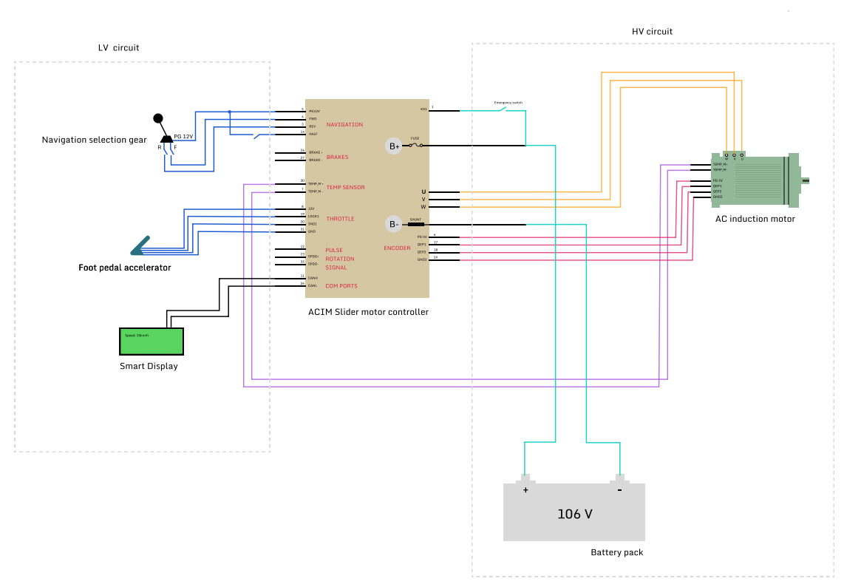
3) Visualize the high voltage and low voltage circuits in the electrical subsystem.

